Slide 2
Interpolation of loudspeaker level balloons from polar measurements by using deep learning
Víctor Manuel Catalá Iborra¹
¹ DAS AUDIO GROUP, Fuente del Jarro, Spain

Slide 3
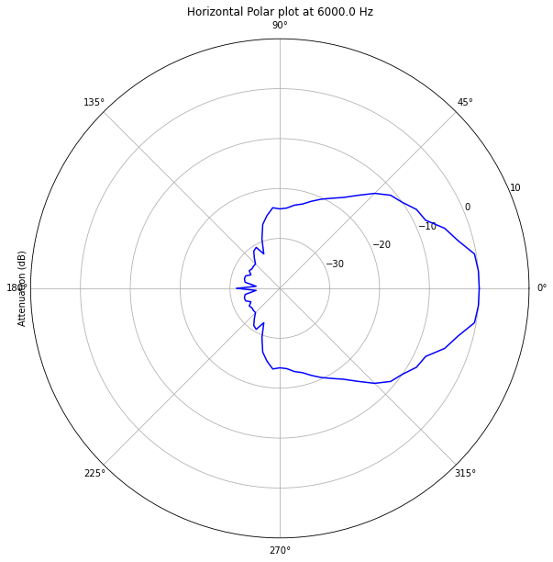
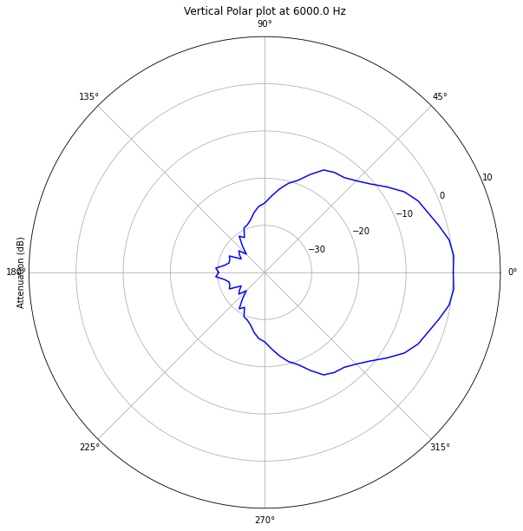
Motivation
Polar diagrams.

Slide 4
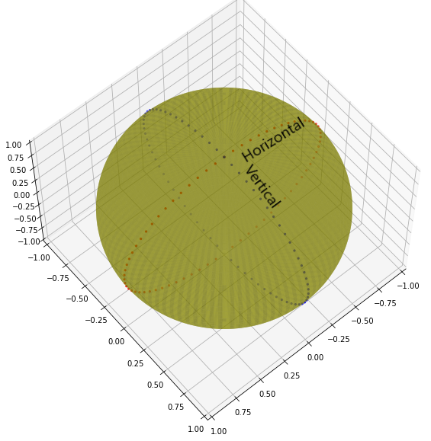
Motivation
Horizontal (red) and vertical (blue) polar measurement points.

Slide 5
Motivation
Loudspeaker radiation balloon (level and phase)
Notes:
Design, design verification, loudspeaker models for simulation software

Slide 6
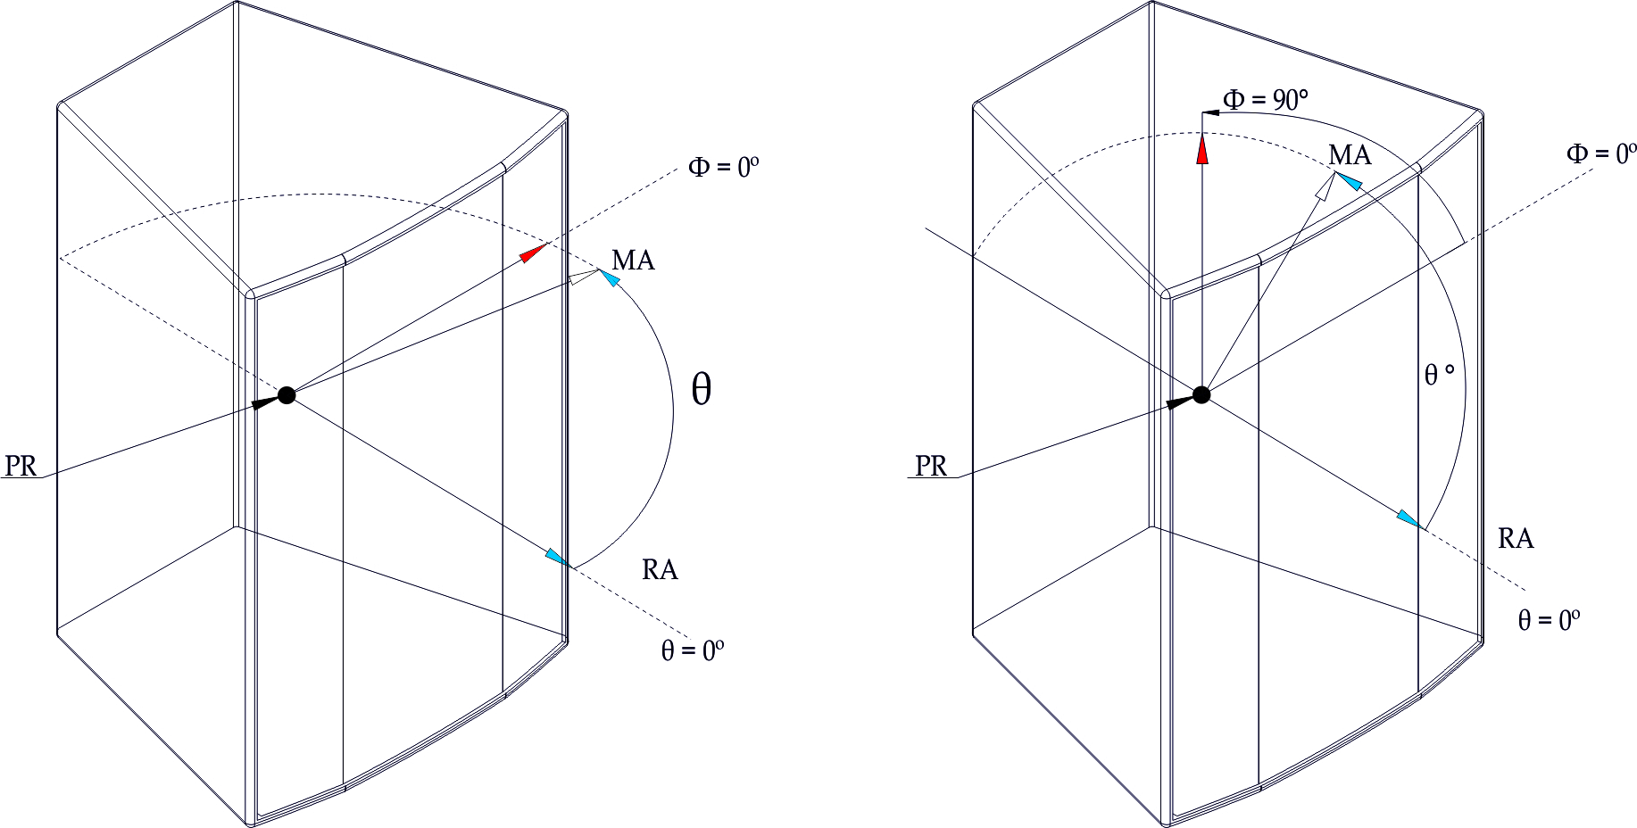
Motivation
Polar system coordinates per AES, 2008 (reaffirmed 2014).

Slide 7
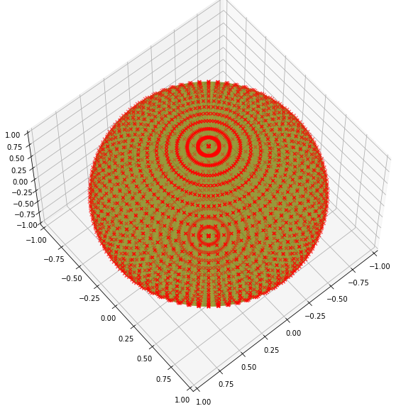
Motivation
2664 measurement points which means 82584 SPL values with 1/3 oct resolution

Slide 8
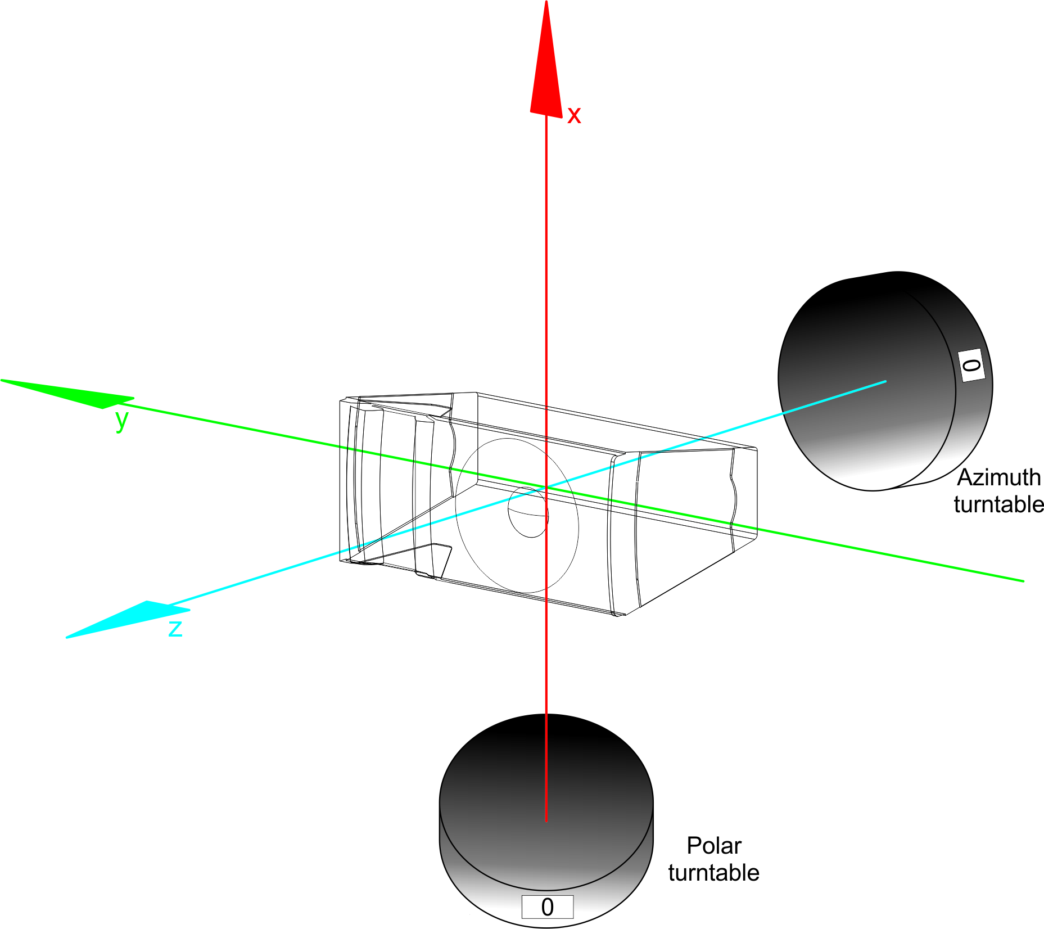
Motivation
3D acquisition system with 2 turntables.

Slide 9
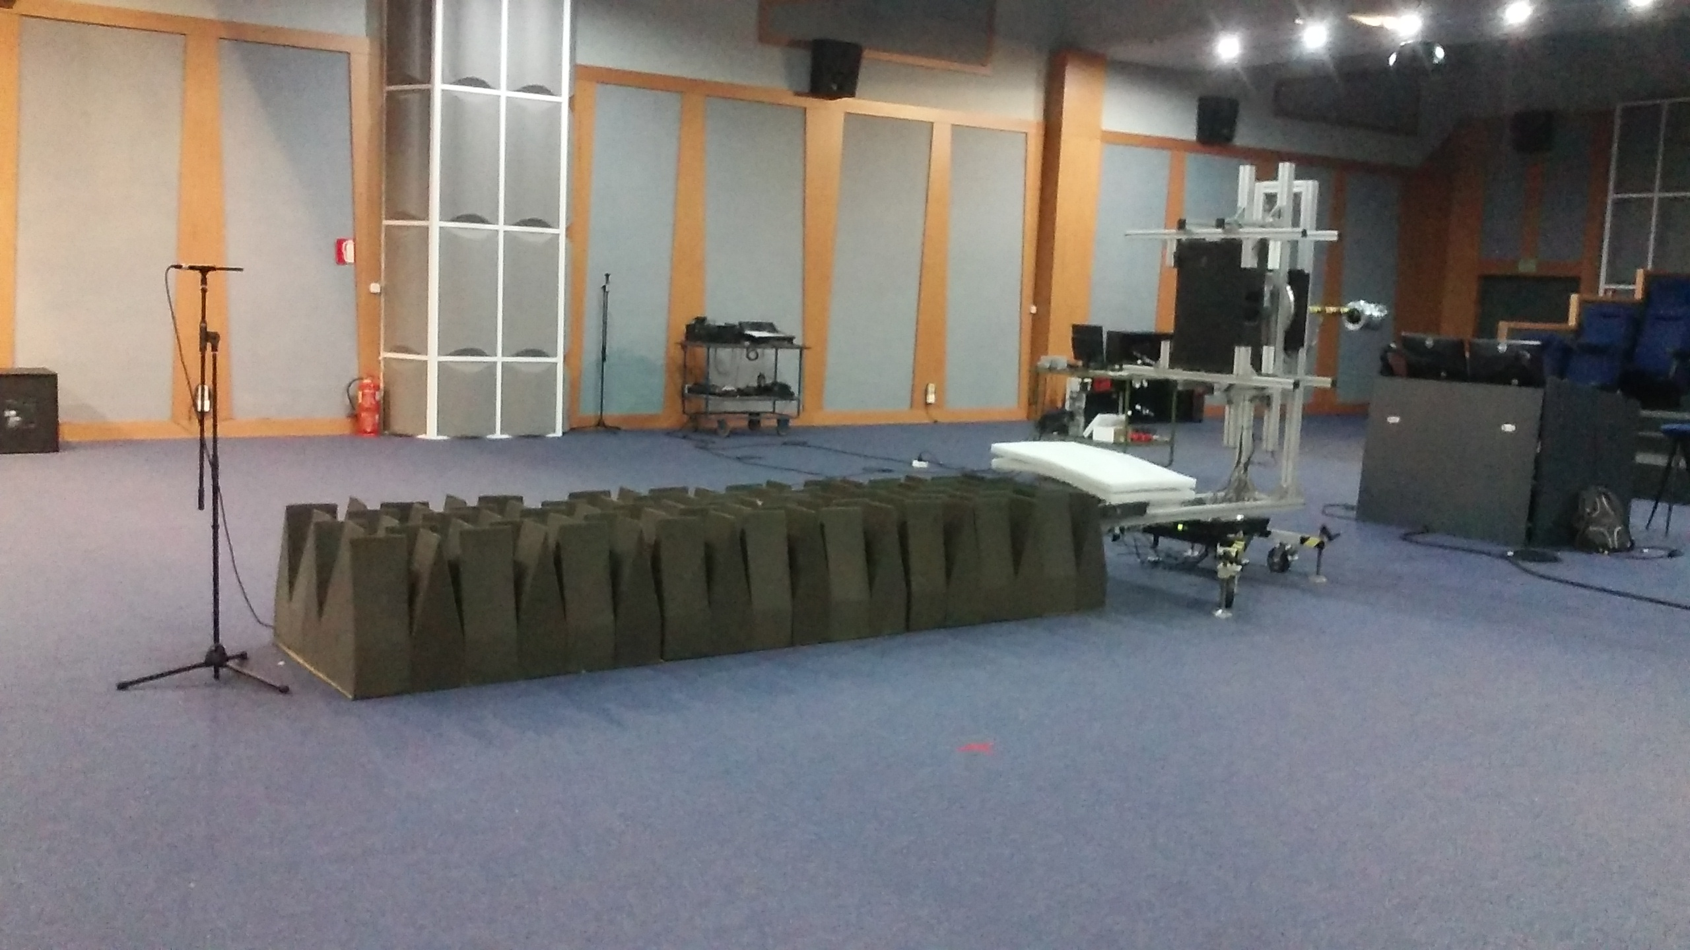
Motivation
Measurement set-up at DAS Audio Auditorium.
Notes:
2 turntables, big enough to allow window techniques down to 160Hz, low RT, low noise. Not available for other pourposes while measuring and setup

Slide 10
Motivation
Loudspeaker radiation balloon (level and phase)

Slide 11
Method
Traditional interpolation methods are based on the data of the loudspeaker being analyzed
Neural networks allow us to take profit of many loudspeaker data to build a model and then, apply it to a specific loudspeaker.

Slide 12
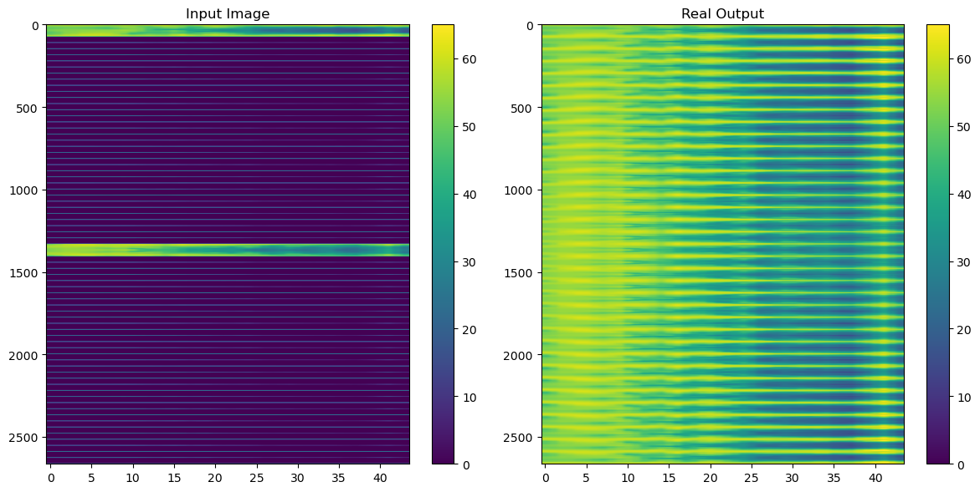
Method
The problem is reduced to an incomplete-image recovery problem

Slide 13
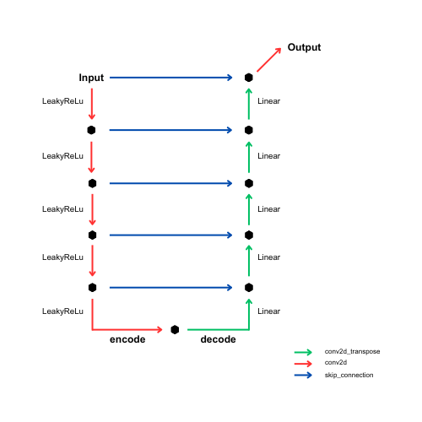
Method
Proposed U-net architecture

Slide 14
Method
Layer Input size Stride Padding Kernel size Output size
conv2d_44 (2664, 44, 1) (2, 1) valid (75, 3) (1295, 42, 16)
conv2d_45 (1295, 42, 16) (2, 2) valid (75, 3) (611, 20, 32)
conv2d_46 (611, 20, 32) (2, 2) valid (75, 3) (269, 9, 64)
conv2d_47 (269, 9, 64) (2, 2) valid (75, 3) (98, 4, 128)
conv2d_48 (98, 4, 128) (2, 2) valid (75, 3) (12, 1, 256)
conv2d_transpose_32 (12, 1, 256) (2, 1) valid (76, 4) (98, 4, 128)
conv2d_transpose_33 (98, 4, 256) (2, 2) valid (75, 3) (269, 9, 64)
conv2d_transpose_34 (269, 9, 128) (2, 2) valid (75, 4) (611, 20, 32)
conv2d_transpose_35 (611, 20, 64) (2, 2) valid (75, 4) (1295, 42, 16)
conv2d_transpose_36 (1295, 42, 32) (2, 1) valid (76, 3) (2664, 44, 16)
conv2d_49 (2664, 44, 17) NA same (75, 4) (2664, 44, 1)
Parameters of the proposed U-net.

Slide 15
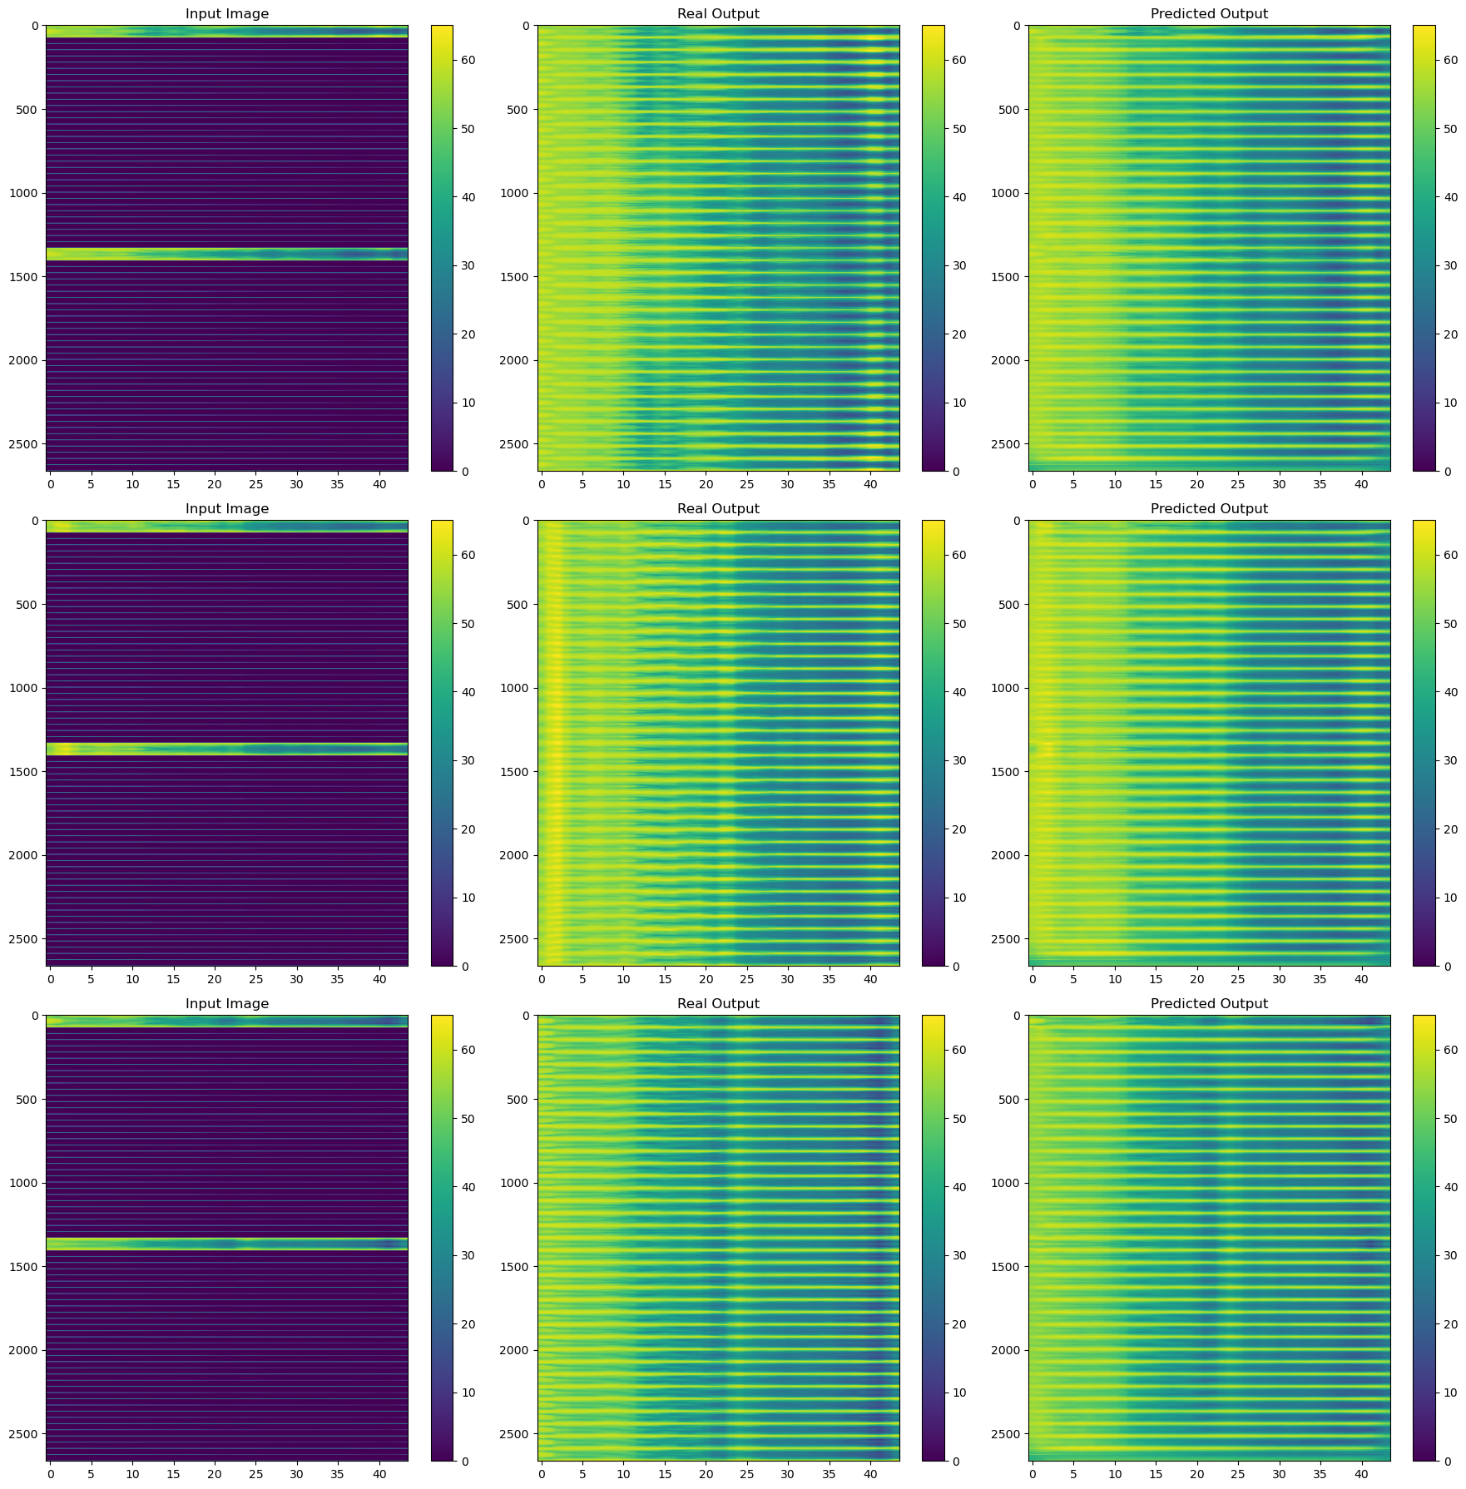
Results
Training data images 1-2-3. Left column: only polar data. Central column: ground truth. Right: U-net prediction

Slide 16
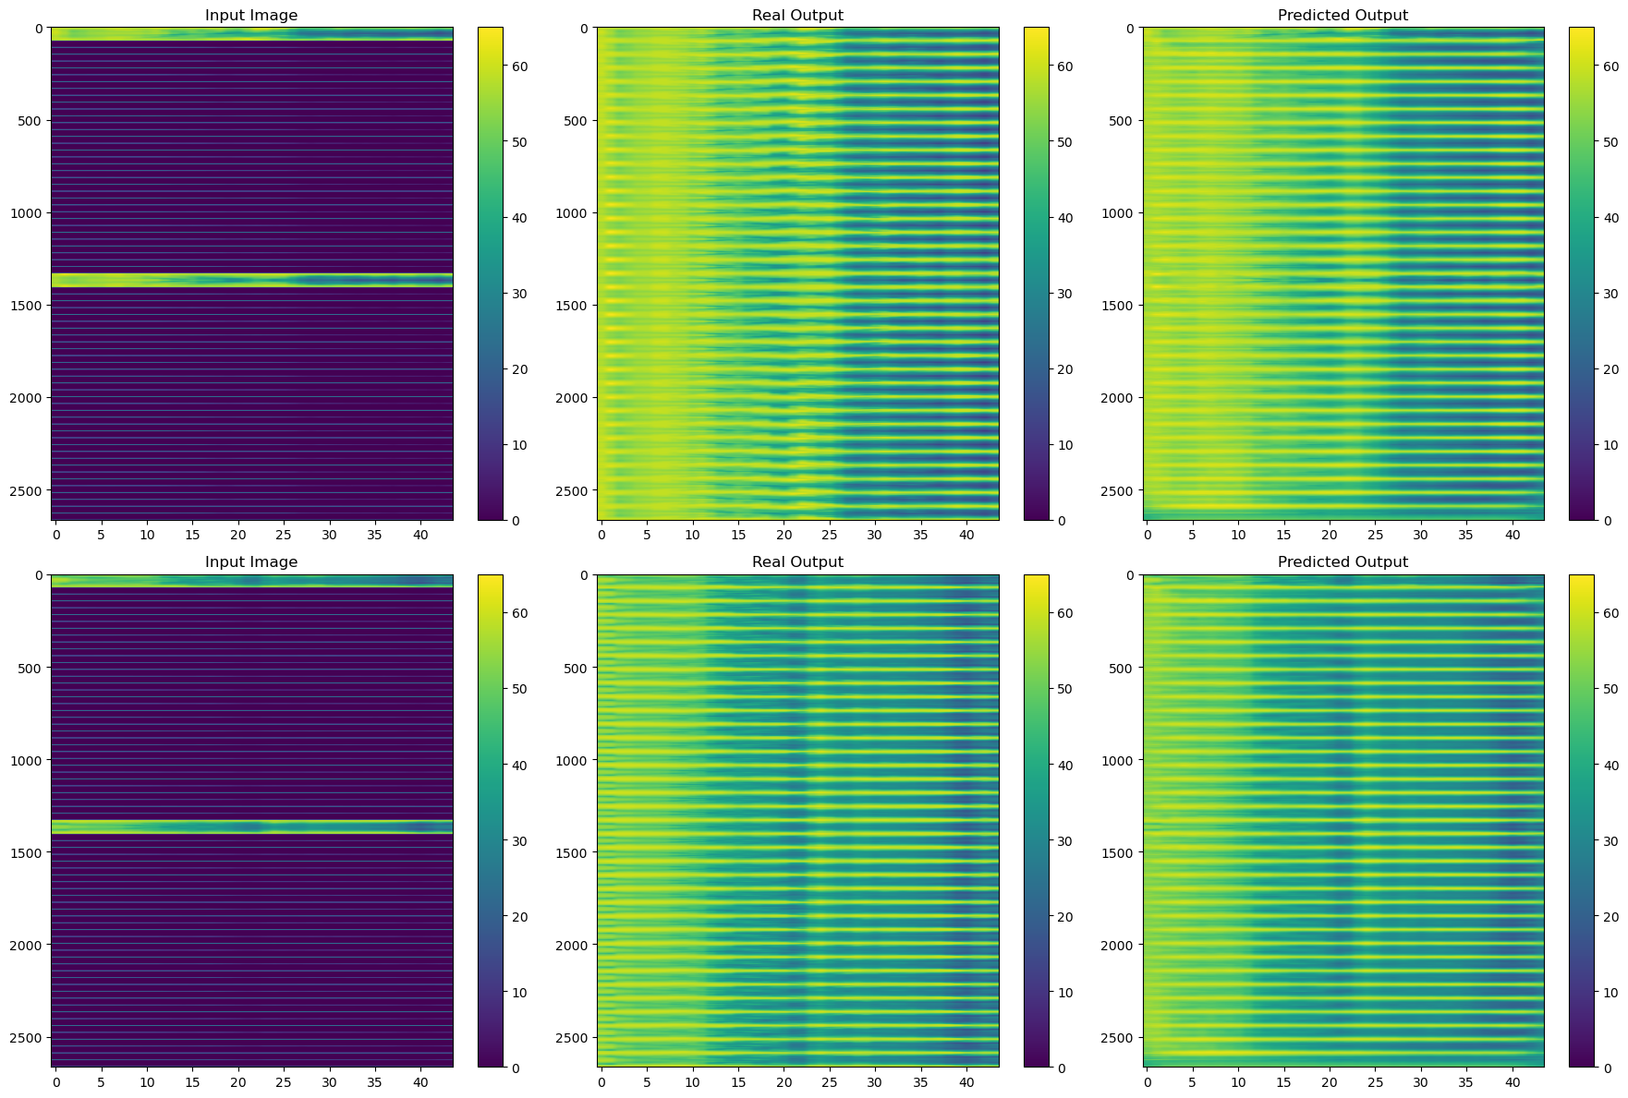
Results
Training data images 4-5. Left column: only polar data. Central column: ground truth. Right: U-net prediction

Slide 17
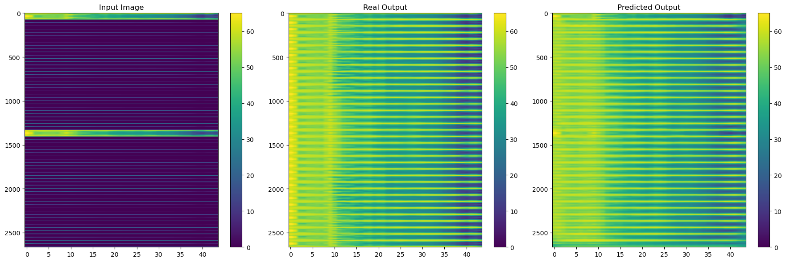
Results
Validation data. Left column: only polar data. Central column: ground truth. Right: U-net prediction

Slide 18
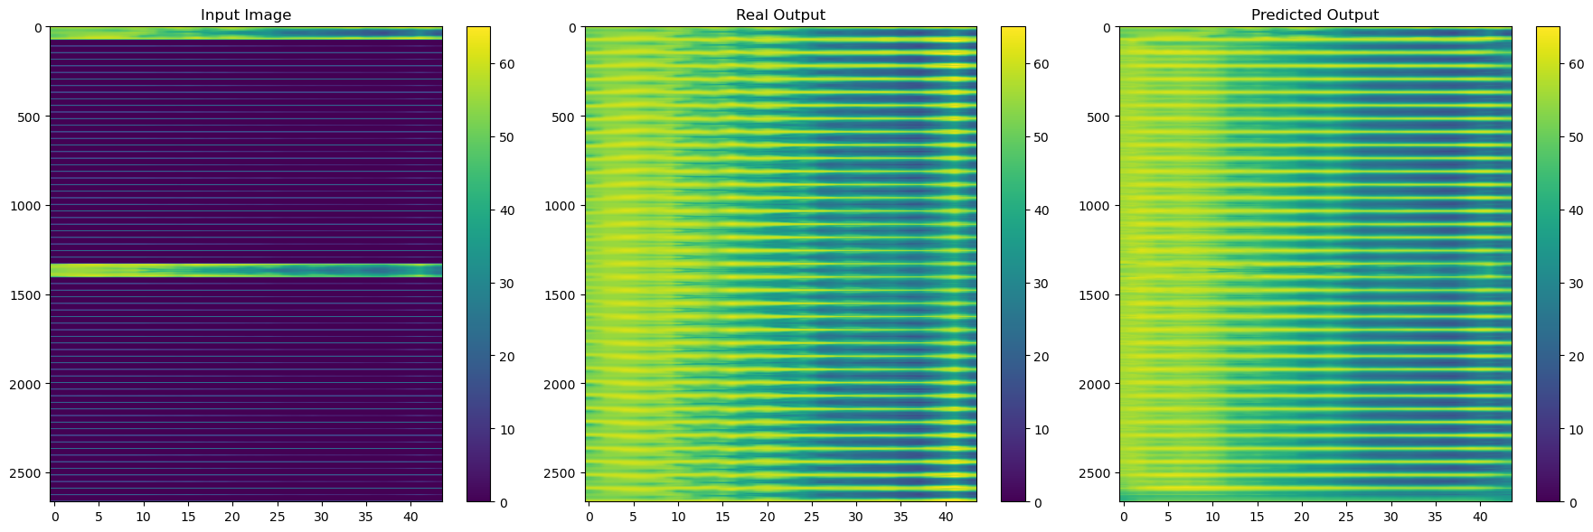
Results
Test data. Left column: only polar data. Central column: ground truth. Right: U-net prediction

Slide 19
Results
 | Mean Absolute Error (MAE)
Training data | 2.8 dB
Validation data | 4.0 dB
Test data | 3.8 dB

Slide 20
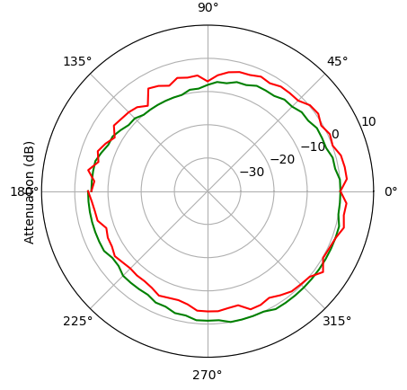
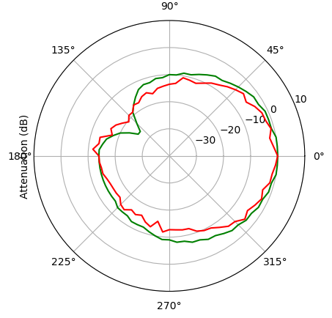
Results
Polar plot at Phi=45º - 250 Hz
Polar plot at Phi=45º - 500 Hz

Slide 21
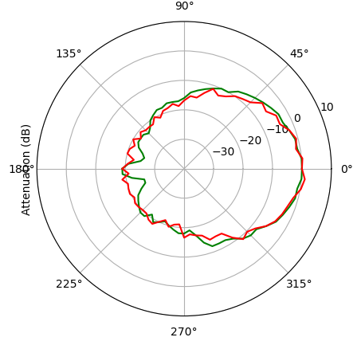
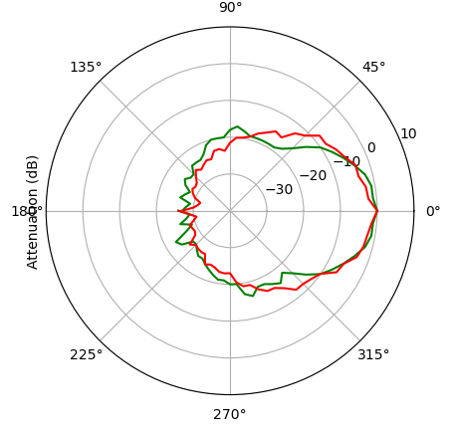
Results
Polar plot at Phi=45º - 1 kHz
Polar plot at Phi=45º - 2 kHz

Slide 22
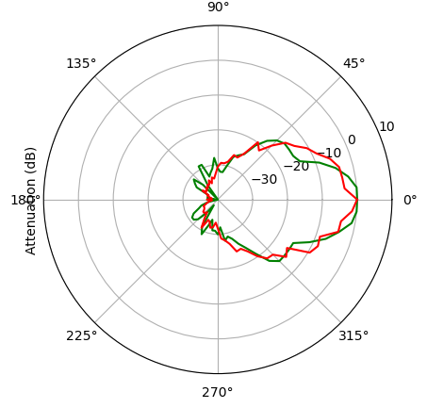
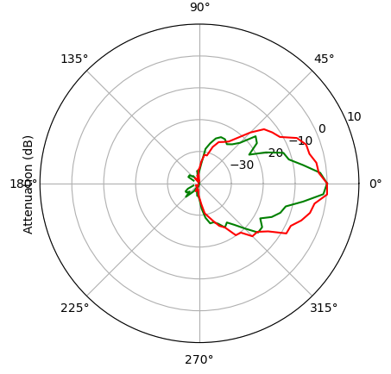
Results
Polar plot at Phi=45º - 4 kHz
Polar plot at Phi=45º - 8 kHz

Slide 23
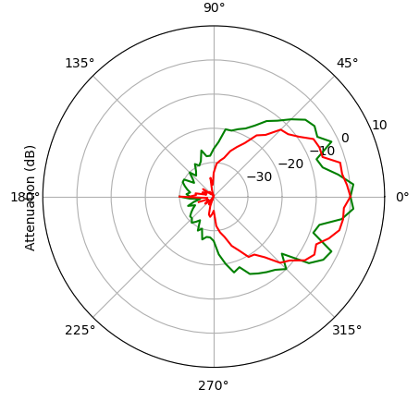
Results
Polar plot at Phi=45º - 16 kHz

Slide 24
Conclusions and further research
Neural Networks can be used to approximate level loudspeaker radiation balloons from polar measurements. In particular, U-net deep learning architectures can provide MAE lower that 4 dB over full balloons.
At high frequencies, with steeper variation of SPL against angles, the performance of the proposed network is lower. Refined architectures, more data and farther research are needed to improve accuracy.
Similar methods could be applied to phase interpolation in order to get complex responses.
More powerful models could be achieved by combining true polar measurements and full 3D simulations (from Finite Element Method software, for example) as input data, to obtain more accurate predictions. In this case, simple polar measurements would refine full 3D simulations.

Slide 25
Thanks!

